Slide 1
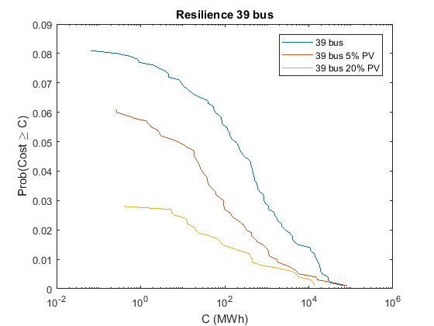
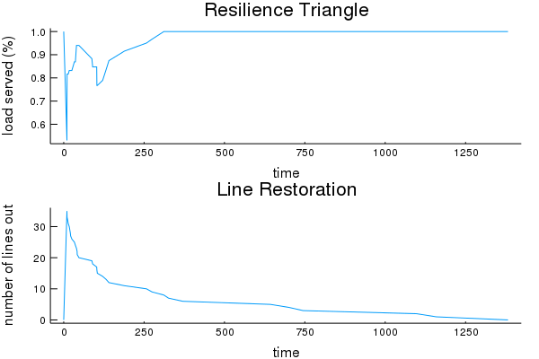
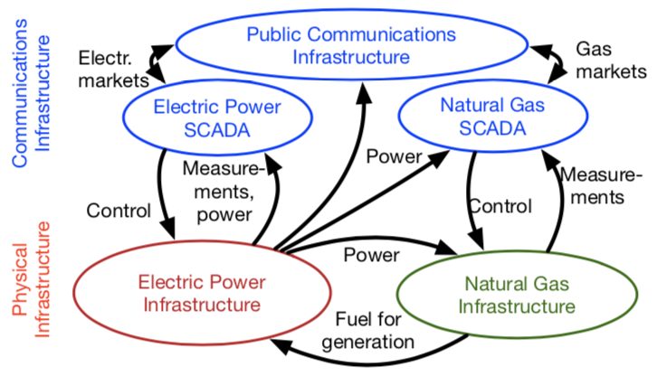
Measuring Power System Resilience Based on Empirical Data
Molly Rose Kelly-Gorham, Paul Hines, Ian Dobson (ISU)
Abstract
Computational methods
Preliminary Results
In this work, we aim to evaluate resilience comprehensively by approximating multiple stages of resilience with probability distributions driven by real data. The number of lines which make up the various contingencies and the recovery time of each line removed from the contingencies were chosen based on distributions derived from data from a large USA utility \cite{BPAdata,Ian18}. A load shedding optimization is used to determine the initial load shed in the system. The restoration times realized from the empirical distribution are used to update the status of the lines in the grid, and an optimal restoration of load is used to determine the minimum load shedding necessary at each step within the restoration process of the grid. We integrate over the cost of load shedding to measure the area that represents unserved load over the fault and restoration process. This paper uses many simulated events to find the complementary cumulative distribution function for a power grid test network. We then test improvements on the grid to see how the resilience distribution changes with the improvements.
This work provides a new integrated approach to quantify resilience in electric power transmission networks and demonstrates the approach by measuring the impact of potential improvements to a power system. A novel aspect is the use of empirical data to develop the probability distributions that drive the model. Research on power system resilience is motivated by climate change, which increases the severity of large storms, and concerns about potential attacks on the electricity infrastructure. A key first step is to quantify the overall resilience of a particular power system.
Model
Initiate outages
Outages ---> Initial lost load, LSOPF
Restoration, LROPF
Resilience metrics
Background
There is a broad existing literature which focuses on each individual stage of the resilience problem, such as component reliability, or cascading failures, or restoration, but there is not much previous work that analyzes all the stages of resilience together to quantify the overall resilience. Previous work quantifies the vulnerability of components to natural forces such as weather \cite{Dunn18}, and quantifies the impact of cascading failures on power outages \cite{Kim_distLS_cascades,clarfeld_assessing_2018}. And many have studied the restoration process after large power outages \cite{Adibi94,Ian18,coffrin15}. Other more comprehensive efforts have produced frameworks and metrics to measure resilience \cite{Bruneau:Resilience-earthquake,Panteli:MetricsResilience}, and have estimated system resilience to certain hazards by applying a good measure of component outages into a resilience framework \cite{Panteli:Fragil-Prob-Adapt}.
Future Work:
Interdependence modeling
Coupling power system, natural gas and communication system models

